Slide 1

Network Visualization and Analysis of Gene Regulatory Interactions in Acute Myeloid Leukemia (AML)
ETHICS, INNOVATION, RESEARCH AND IPR (24AIM115)
MOLECULAR BIOLOGY & BASIC CELLULAR PHYSIOLOGY (24AIM112)
Harithra S. – CB.AI.U4AIM24013
Harshath A. – CB.AI.U4AIM24015
N S Tharika. – CB.AI.U4AIM24027
RA Thanushika Sri. – CB.AI.U4AIM24034
GROUP 12

Slide 2
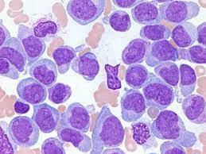
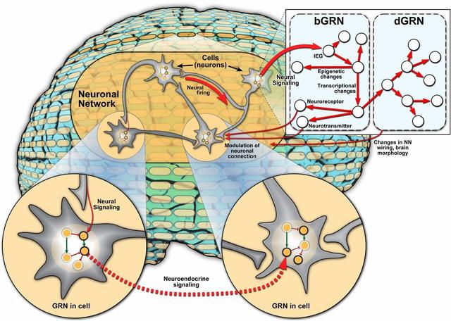
INTRODUCTION
AML is the blood and bone marrow cancer given by rapid overgrowth of abnormal white blood cells.
At the molecular level, AML diagnosis helps in early detection and therapeutic targets.
GRN analysis says about the critical regulatory mechanisms in AML progression.
Acute Myeloid Leukemia (AML)
2
Gene Regulatory Networks (GRNs)

Slide 3
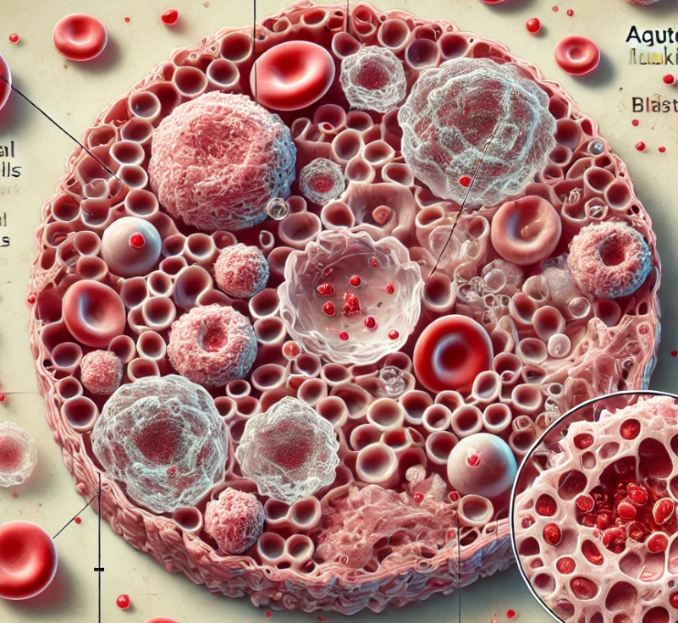
PROBLEM STATEMENT
Despite advancements in treatment,AML prognosis remains poor due to its genetic complexity and heterogeneity.
The identification of key regulatory genes and biomarkers is crucial for improving diagnosis and developing targeted therapies.
Analyze GRN structure to identify key genes and uncover AML-specific mechanisms for biomarkers and therapies.
3

Slide 4
OBJECTIVES
To illustrate the structure and relationships within the GRN.
To perform a detailed network analysis to identify critical genes and their interactions.
To gain insights into AML-specific regulatory mechanisms to highlight potential biomarkers and therapeutic targets.
Adhering to ethical considerations ensures fairness, transparency, and integrity in research.
4

Slide 5
LITERATURE REVIEW
REFERENCE | STUDY | OBJECTIVE | METHODOLOGY | KEY FINDINGS | LIMITATIONS
[1] | “Epigenetic-based differentiation therapy for Acute Myeloid Leukemia”-Edurne San José - Enériz.,2024 | Exploring epigenetic-based differentiation therapy for AML. | Tested DNA methyltransferase and HDAC inhibitors in various models. | Found enhanced efficacy in combination therapies, though differentiation was incomplete. | Challenges: Limited clinical trial data. .
[2] | "Dynamic Modelling of AML Gene Regulatory Networks"- Doe et al., 2023 | Dynamic modelling of gene regulatory networks in AML. | Applied Boolean network models to simulate gene regulatory interactions under therapy. | Predicted regulatory changes and drug resistance mechanisms in AML cells. | Simplistic modeling approach; lacks real-time patient data for validation.
5

Slide 6
LITERATURE REVIEW
REFERENCE | STUDY | OBJECTIVE | METHODOLOGY | KEY FINDINGS | LIMITATIONS
[3] | "Multi-Omics Integration for AML Network Analysis"- Singh et al., 2022 | Integration of multi-omics data for AML regulatory network analysis. | Integrated transcriptomics, epigenomics, and proteomics data using deep learning models. | Provided a multi-layered view of AML networks, identifying potential therapeutic targets. | Computational complexity; requires high-quality, multi-omics datasets often unavailable.
[4] | “Navigating The Ethical Issues In Collaborative Research Relationships Between The Global North- South The Global Health Network License”(2024) | To explore ethical considerations in genomic data sharing, focusing on equity and trust in North-South research collaborations. | Case studies, policies, and frameworks to analyze challenges in genomic collaborations. | Ethical dilemmas arise from inequitable resource distribution and data ownership. | Generalization is constrained by varied regional policies and cultural differences.
6

Slide 7
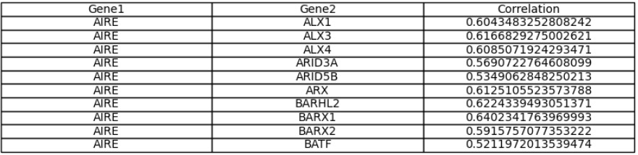
COMPUTATIONAL ASPECTS
DATASET
Gene1: Represents the source gene in the interaction.
Gene2: Represents the target gene that interacts with Gene1.
Correlation: Indicates the strength of the interaction between Gene 1 and Gene 2. A higher value means a stronger relationship.
7

Slide 8
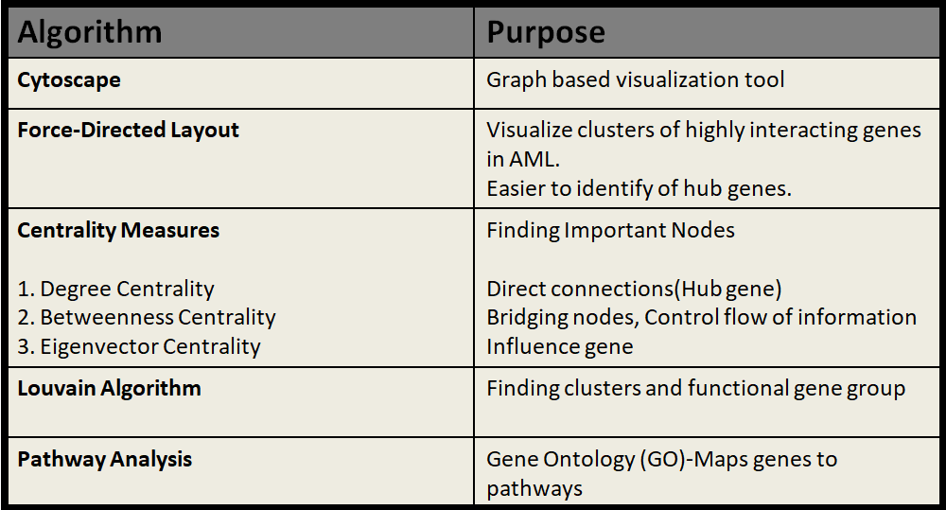
ALGORITHMS:
8

Slide 9
WORKFLOW
Biological Interpretation
Data Exploration and Preprocessing
Network Visualization
Ethical Considerations and Innovation
Network Construction
Network Analysis
Deliverables
9

Slide 10
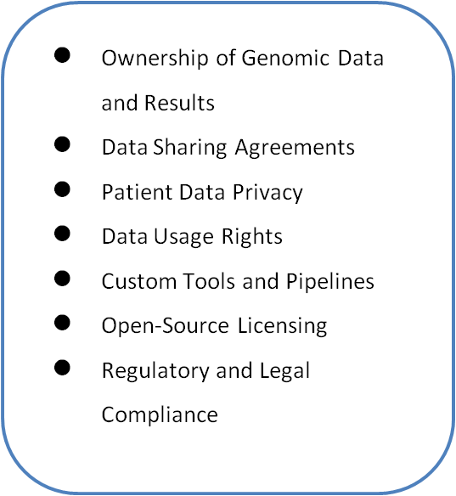
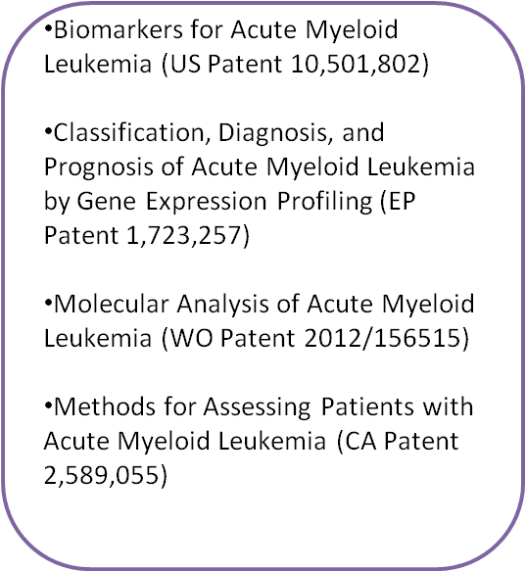
INTELLECTUAL PROPERTY RIGHTS(IPR)
EXISTING PATENTED MODELS
10

Slide 11
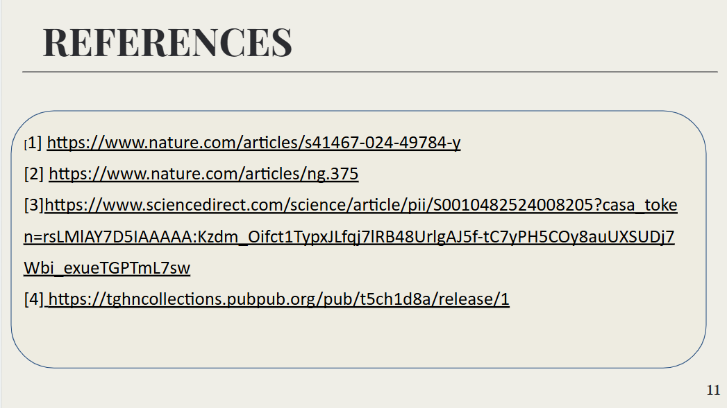
REFERENCES
[1] https://www.nature.com/articles/s41467-024-49784-y
[2] https://www.nature.com/articles/ng.375
[3]https://www.sciencedirect.com/science/article/pii/S0010482524008205?casa_token=rsLMlAY7D5IAAAAA:Kzdm_Oifct1TypxJLfqj7lRB48UrlgAJ5f-tC7yPH5COy8auUXSUDj7Wbi_exueTGPTmL7sw
[4] https://tghncollections.pubpub.org/pub/t5ch1d8a/release/1
11

